Slide 1
Pick and place Robotic arm
Dr. Mohan R
Robotics professor
B1 slot Students
Team

Slide 2
Teamates
Manohar Reddy
21BRS1177
Sivanaga Raju
21BRS1389
Komal Surya Narayana
21BRS1280
Raghava Surya Ganesh
21 BRS1614

Slide 3
Contents
Introduction
What is the idea?
Project
Materials used
Budget
Code
Project working
Conclusion

Slide 4
Introduction
The function of colour identification was done by an integrated colour sensor. The arm (developed) reads the angles of the joints and moves the actuators to pick reach a desired object. The robotic arm sorted objects based on the colour codes given by the end-effectors' colour sensors.

Slide 5
Idea of our project
Our aim to make a robotic arm to play xoxo game with humans which need a lot conceps like machine learning and computer vision .
Basic idea of our goal
https://www.instagram.com/reel/CoM41asuk0W/?utm_source=ig_web_copy_link

Slide 6
Concepts
Apparatus | Quantity | Cost
Robotic arm | 1 | 800
Arduino uno R3 | 1 | 500
servo motors | 4 | 100 *4 = 400
Gy -11 sensor | 1 | 400
Bread board | 1 | 100
joy sticks | 2 | 40 *2 = 80
Jumpers | as many | 30

Slide 7
Material used
Robotiv Arm
2. Servo moters - 4
Arduino uno r3
GY- 11 colour sensor
Breadboard
Jumpers
Joysticks
.
.
.
.

Slide 8
RS.2,310
Estimation of budget

Slide 9
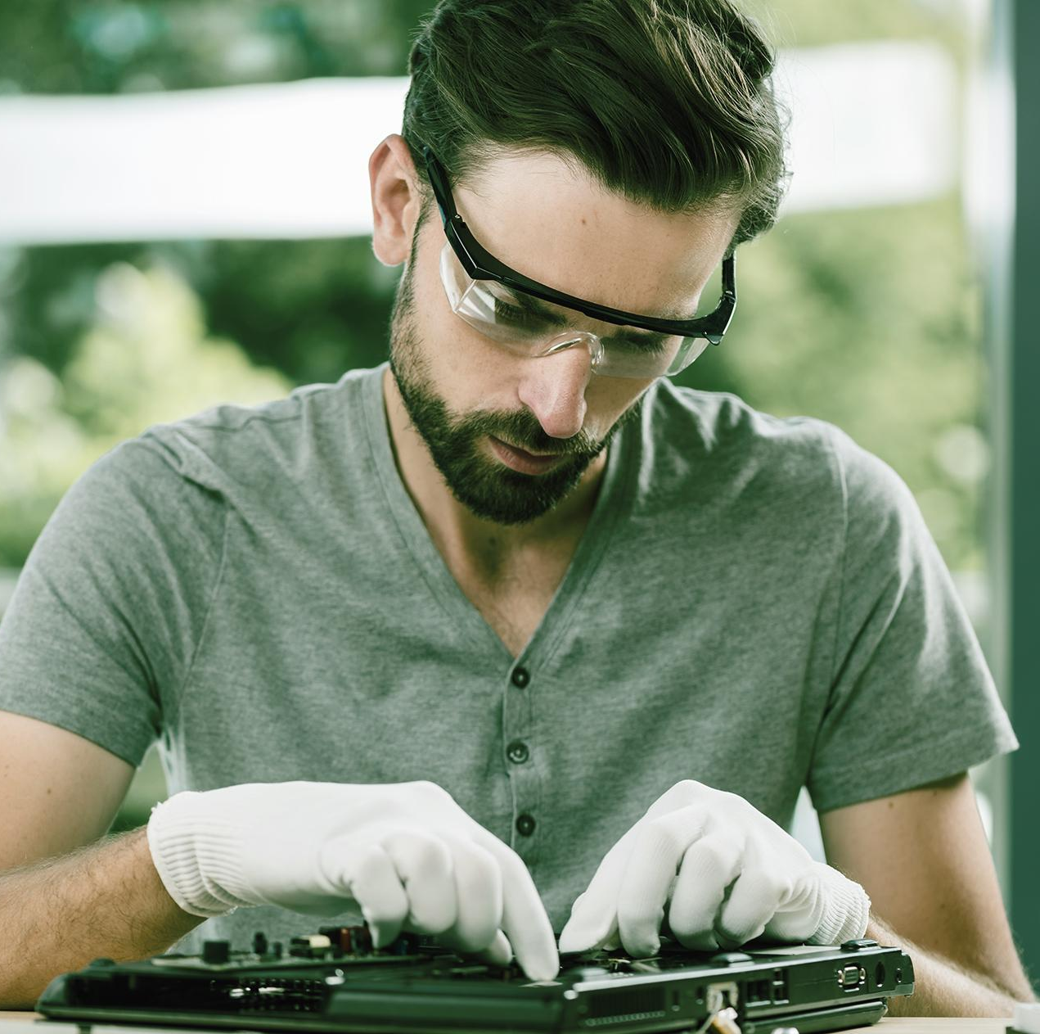
Practice
.

Slide 10


Slide 11
Code
Run in Arduino app
https://github.com/manoharreddyvoladri/Robotic-Arm

Slide 12
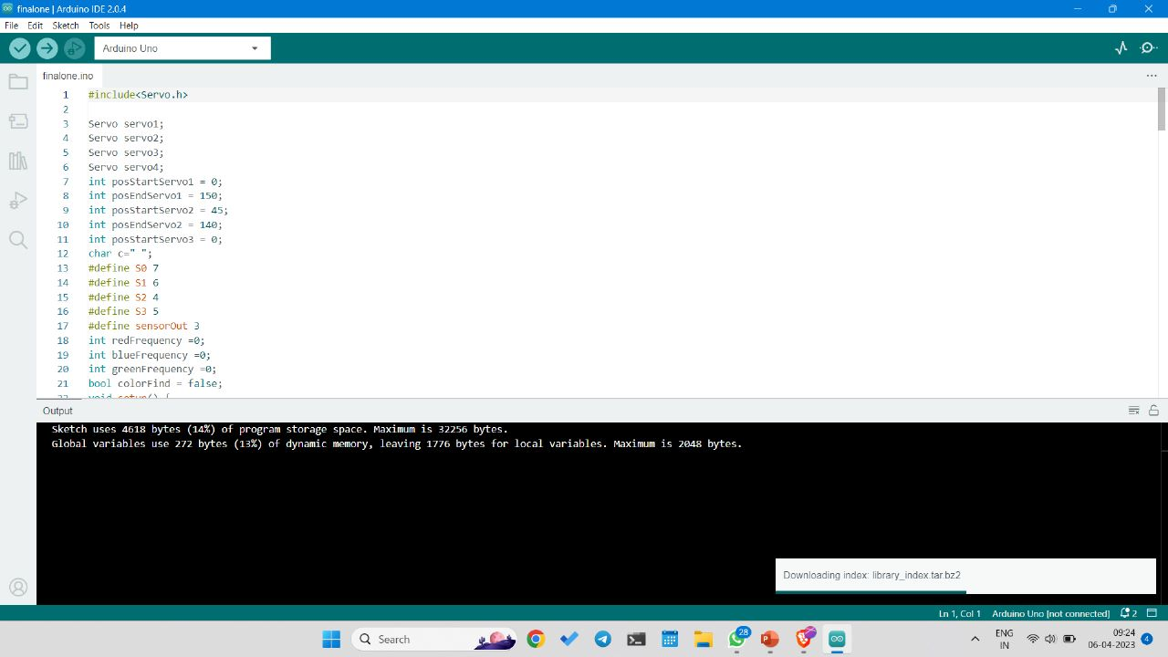

Slide 13
Thank you sir

